Slide 1
API
(Application Programming Interface)
BY : ARVIND SHARMA

Slide 2
API
Application programming interface.
What is API- An application program interface (API)
is code that allows two software programs to commu
-nicate to each other. An API defines the correct way
for a developer to request services from an operating
system.

Slide 3
HOW API WORK
API are made up of two elements.
1. Specification: That describes how information is
exchanged between programs.
2. Software Interface: Software interface written to
specification and published in some way for use.

Slide 4
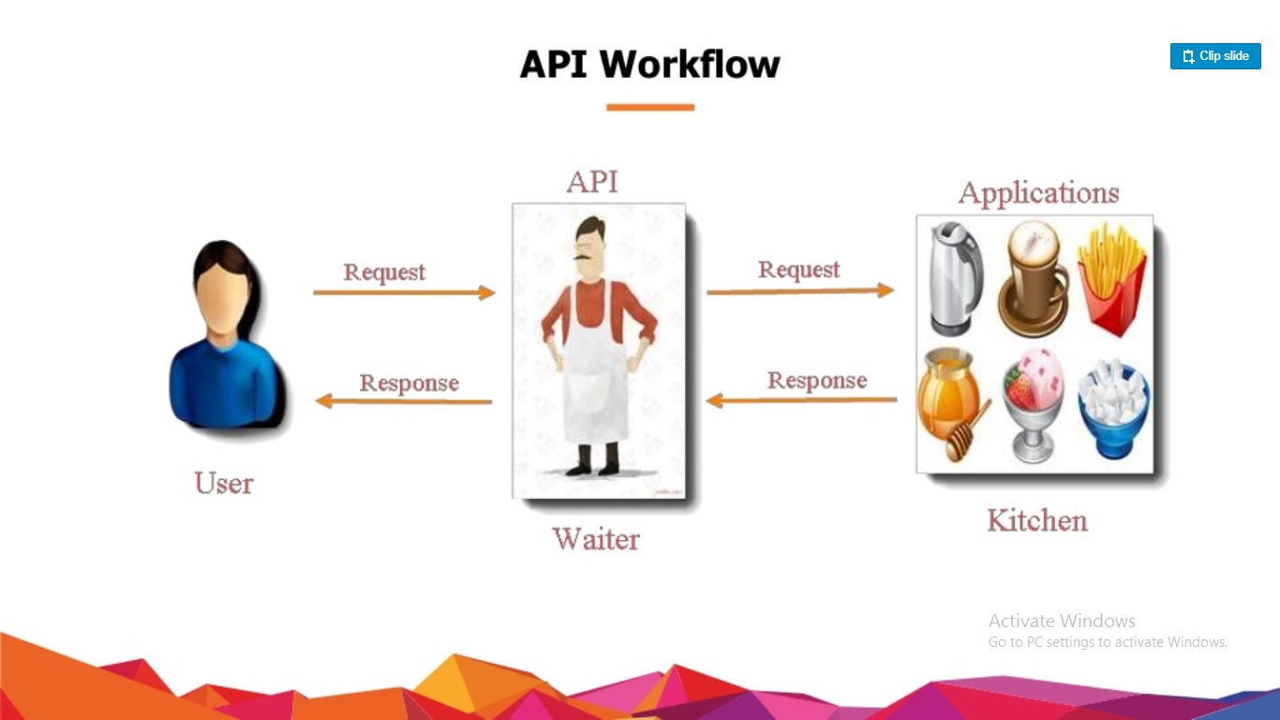
API WORKFLOW

Slide 5
API
APIs take three basic forms: Private, Public & Partner.
Private: Private APIs are not exposed to third parties &
It is used in private company’s to improve the quality of
own product and services.
Ex: Home-cost.
Public: These APIs are published publicly and can be
use by any third party. There are no restrictions on the-
-se APIs.
Ex: Twilio, Uber.

Slide 6
CONT’D
Partner: Partner APIs can only be used by specific par-
-ties with whom the company agrees to share data.
Partner APIs are used in business relationships, often
to integrate software between partnering companies.
Ex: Shopify.

Slide 7
Advantage of API
API is that it allows your users to do more with your product or service.
an integration - An example of an integration is to push notifications from your product (such as CRM, Helpdesk) to a messaging tool such as Slack. In this way, if your customer uses Slack they can receive notifications without having to login directly to your system or check emails.
new functionality - In the early days of Twitter, some of the most popular Twitter clients were produced by third parties using the Twitter API. Twitter and its users benefited from the new functionality that was undertaken by other companies.

Slide 8
Disadvantage of API
Cost - Providing an API is expensive in terms of development time, ongoing maintenance, providing API documentation on your website and providing support to users of your API.
Security exposure - Adding an API adds another attack surface to your website.
You might not like the result or you may change business direction - It's not always easy to predict exactly how your API will be used. If your integration with a messaging system means that users login to your service less often, will there be an overall negative impact for you

Slide 9
Web Service APIS
A web service is a system or software that uses an address, i.e., URL on the World Wide Web, to provide access to its services The following are the most common types of web service APIs:
SOAP
XML-RPC
JSON-RPC
REST

Slide 10
Web Service APIS
SOAP (Simple Object Access Protocol): This is a protocol that uses XML as a format to transfer data. Its main function is to define the structure of the messages and method of communication. It also uses WSDL, or Web Services Definition Language, in a machine-readable document to publish a definition of its interface.
XML-RPC: This is a protocol that uses a specific XML format to transfer data compared to SOAP that uses a proprietary XML format. It is also older than SOAP. XML-RPC uses minimum bandwidth and is much simpler than SOAP.

Slide 11
Web Service APIS
JSON-RPC: This protocol is similar to XML-RPC but instead of using XML format to transfer data it uses JSON.
REST (Representational State Transfer): REST is not a protocol like the other web services, instead, it is a set of architectural principles. The REST service needs to have certain characteristics, including simple interfaces, which are resources identified easily within the request and manipulation of resources using the interface.

Slide 12
Difference b/w Soap and Rest API
SOAP
It has strict rules and advanced security to follow.
It is driven by Function
It requires more Bandwidth
REST
There are loose guidelines to follow allowing developers to make recommendations easily.
It is driven by Data
It requires minimum Bandwidth

Slide 13
Difference b/w JSON and XML
JSON
Supports only text and numbers.
Focuses mainly on Data.
It has low security.
XML
Supports various types of data for example text, numbers, images, graphs, charts etc.
Focuses mainly on Document.
It has more security.

Slide 14
Method to Test API
GET- The GET method is used to extract information from the given server using a given URI. While using GET request, it should only extract data and should have no other effect on the data.
POST- A POST request is used to create a new entity. It can also be used to send data to the server, for example, customer information, file upload, etc. using HTML forms.
PUT- Create a new entity or update an existing one.
DELETE- Removes all current representations of the target resource given by a URI.

Slide 15
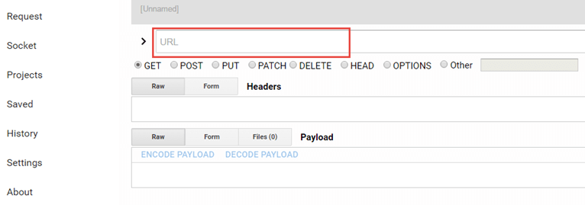
Test Rest API by Advanced rest client
Step 1): Launch the extension once it is installed successfully

Slide 16
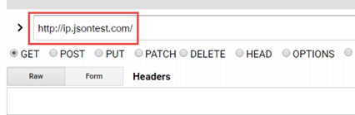
Test Rest API by Advanced rest client
Step 2): Enter the URL of the API in the URL textbox

Slide 17

Test Rest API by Advanced rest client
Step 3): Select the radio button for the type of HTTP method to hit- e.g. POST

Slide 18

Test Rest API by Advanced rest client
Step 4) : Provide Headers (if required), in the Headers textbox. Sometimes we need to give headers

Slide 19
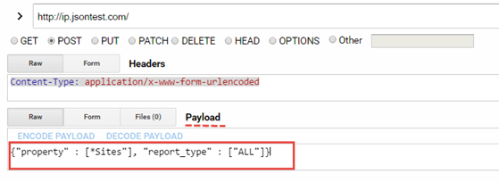
Test Rest API by Advanced rest client
Step 5): Under Payload, pass the request body of the API in the form of key-value pairs e.g. {{"key1":"value1","key2":"value2"}. If it is post API, then we need to pass body or parameters.

Slide 20
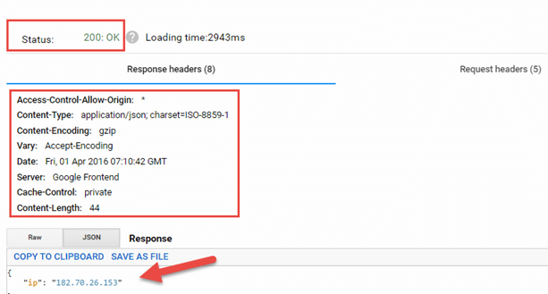
Test Rest API by Advanced rest client
Step 6): Hit the send button. After clicking on "send" button, you will see response something like this.

Slide 21
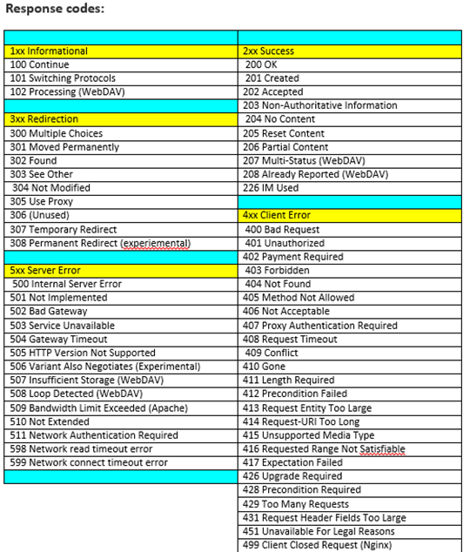
Response code

